Slide 1
Week 01 CST2555 2023/24 Operating Systems and Computer Networks
Dr Ali Khoshkholghi
a.khoshkholghi@mdx.ac.uk
Lecturer in Computer Science

Slide 2
Introduction
This module includes two parts:
First part: Introduction to Operating Systems – With Dr Ali Khoshkholghi (me)
Start today, and finish by the end of week 12.
Second part: Computer Networks
Start week 13 until week 24.
Assessment:
Coursework 1: 20%.
Lab test: 15%
In-class test: 15%.
Module textbook:
Operating System Concepts with Java, Silberschatz, Galvin and Gagne, 10th Edition, John Wiley & Sons.

Slide 3
Syllabus – What we will learn this term
Introduction
Operating system structure and design
Processes
Multithreading
CPU scheduling
Deadlocks
Memory management
Virtual memory and paging
File systems
Virtual machines
Protection and security

Slide 4
What we will learn in Week 01
What Operating Systems Do
Computer-System Organization
Computer-System Architecture
Operating-System Operations
Resource Management
Security and Protection
Virtualization
Distributed Systems
Kernel Data Structures

Slide 5
What is an Operating System?
A program that acts as an intermediary between a user of a computer and the computer hardware.
Operating system goals:
Execute user programs and make solving user problems easier
Make the computer system convenient to use
Use the computer hardware in an efficient manner
User view: Designed for ease of use
System view: Designed for resource allocation.

Slide 6
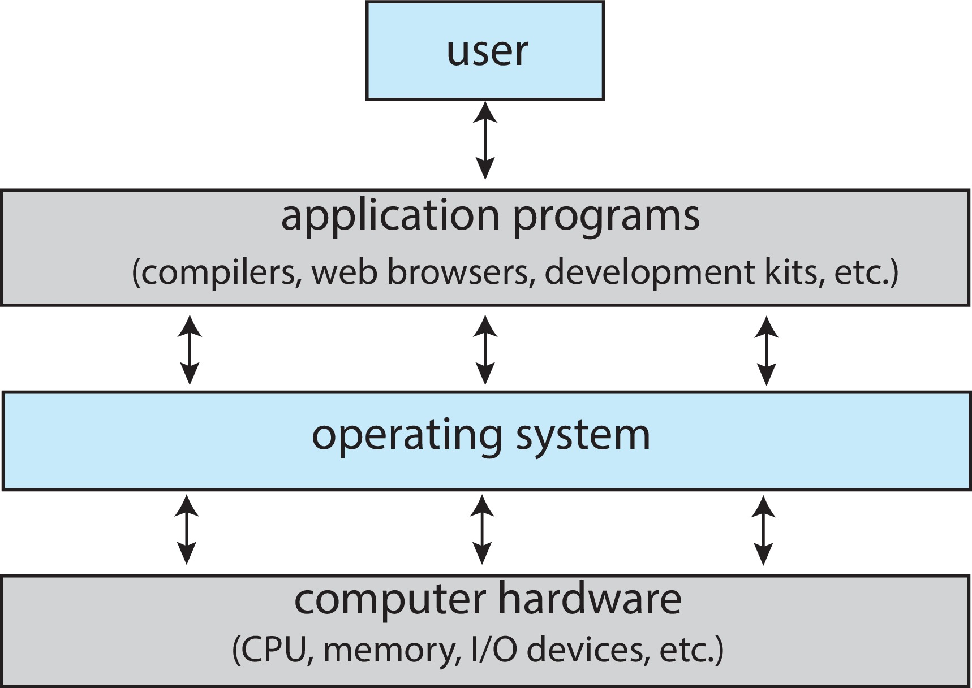
Computer System Structure
Computer system can be divided into four components:
Hardware – provides basic computing resources
CPU, memory, I/O devices
Operating system
Controls and coordinates use of hardware among various applications and users
Application programs – define the ways in which the system resources are used to solve the computing problems of the users
Word processors, compilers, web browsers, database systems, video games
Users
People, machines, other computers

Slide 7
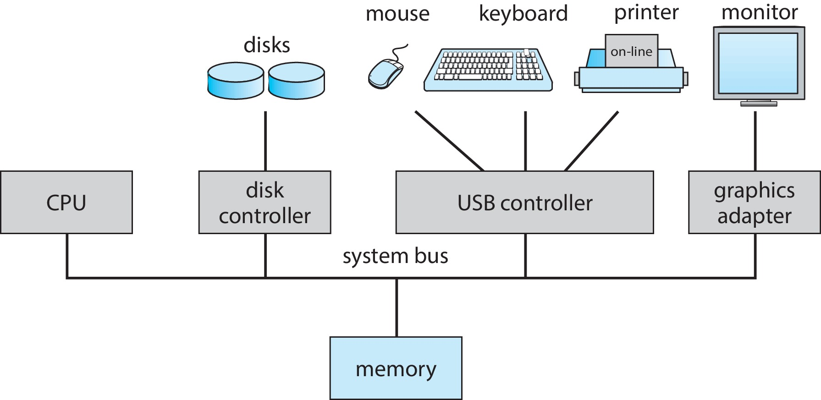
Computer System Operation
One or more CPUs, device controllers connect through common bus providing access to shared memory.
Buses: Shared Communication wires
address lines transmit the RAM location of the data being processed or the instruction being fetched.
data lines transport data
control lines used by the CPU to communicate with devices
Concurrent execution of CPUs and devices competing for memory cycles.
Three key aspects:
Interrupts
Booting
Storage

Slide 8
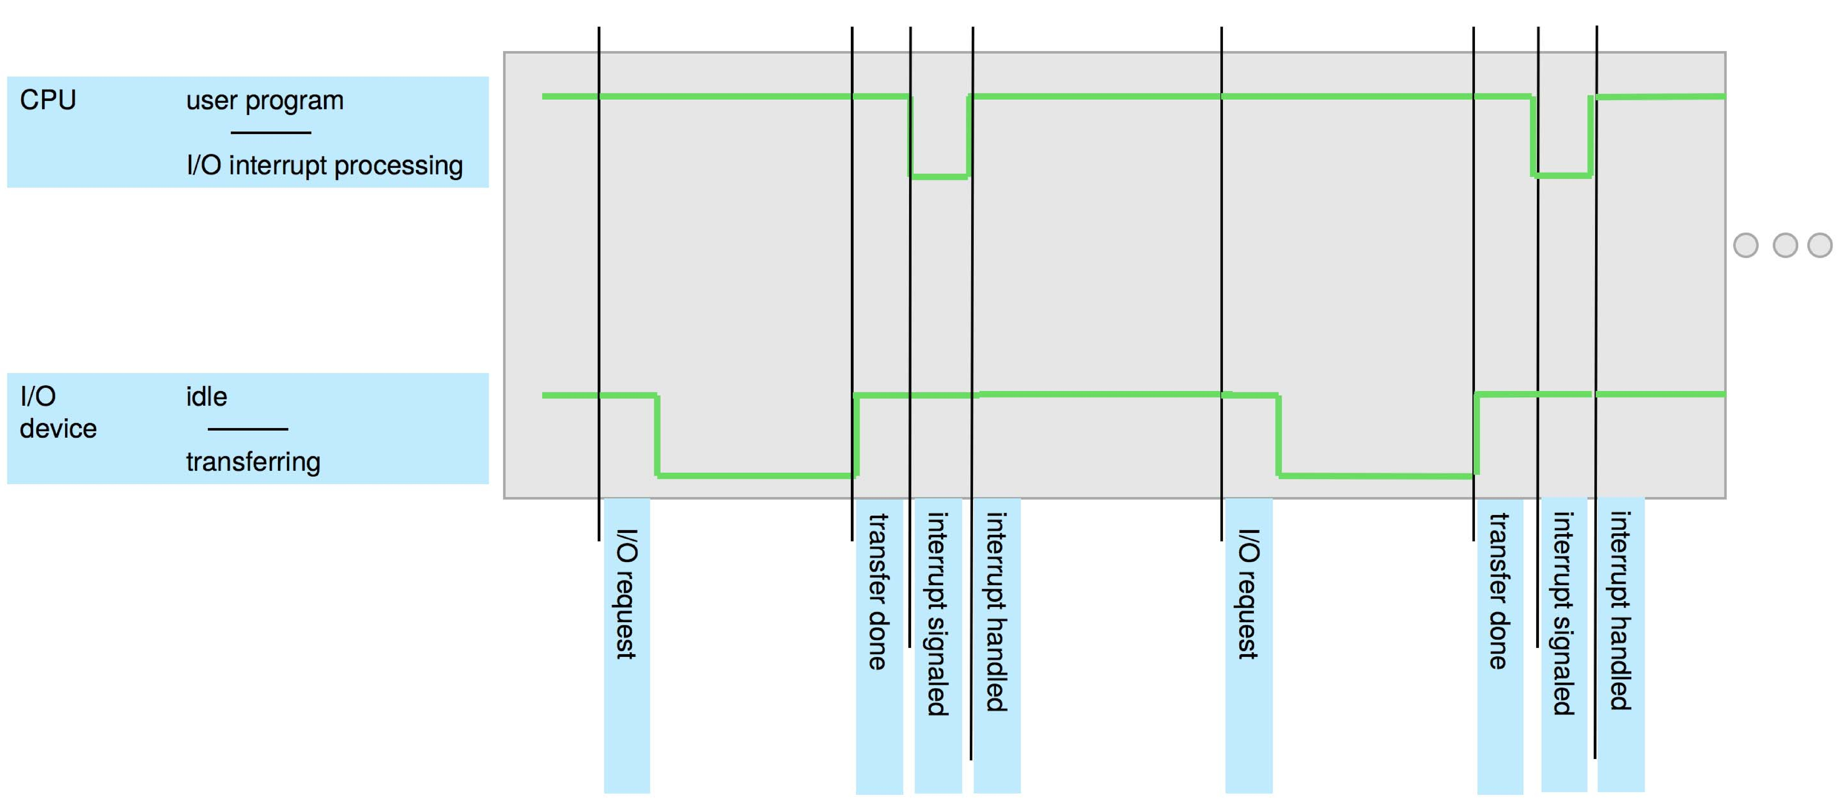
Interrupts
Device controllers communicate with CPU via interrupts
Controller controls interaction between device and local buffer
CPU moves data between main memory and device buffer
Controller informs CPU it is finished by raising an interrupt.
The operating system preserves the state of the CPU by storing the registers and the program counter.
Determines which type of interrupt has occurred.

Slide 9
Interrupt-drive I/O Cycle

Slide 10
I/O Structure
Two methods for handling I/O:
After I/O starts, control returns to user program only upon I/O completion
Wait instruction idles the CPU until the next interrupt
At most one I/O request is outstanding at a time, no simultaneous I/O processing
After I/O starts, control returns to user program without waiting for I/O completion
Simultaneous I/O processing
Device-status table contains entry for each I/O device indicating its type, address, and state
OS manages the I/O devices and corresponding interrupts

Slide 11
Computer Startup
Bootstrap program executes when machine powered on Typically stored in ROM, generally known as firmware
Initializes all aspects of system: memory and device controllers
Loads operating system kernel and starts execution
Kernel enables processes to be created, devices to be read/written, file system to be accessed

Slide 12
Storage definitions
Basic unit of computer storage is the bit, containing either 0 or 1
A byte (or octet) is 8 bits, typically the smallest convenient chunk of storage
E.g., most computers can move a byte in memory but not a single bit
A word is a given computer architecture’s native unit of data, one or more bytes
E.g., a computer with 64-bit registers and 64-bit memory addressing typically has 64-bit (8- byte) words
Storage generally measured and manipulated collections of bytes
A kilobyte (KB) is 1,024 bytes
A megabyte (MB) is 1,0242 bytes
A gigabyte (GB) is 1,0243 bytes
A terabyte (TB) is 1,0244 bytes
A petabyte (PB) is 1,0245 bytes
Manufacturers often round so a megabyte is 1 million bytes and a gigabyte is 1
billion bytes

Slide 13
Storage Structure
Main memory – only large storage media that the CPU can access directly
volatile
Random-access in the form of Dynamic Random-access Memory (DRAM) technology.
Secondary storage – extension of main memory that provides large nonvolatile storage capacity

Slide 14
Storage Structure (Cont.)
Hard Disk Drives (HDD) –
The disk controller determines the logical interaction between the device and the computer
Solid-state disks(SSD), faster than hard disks
Caching – copying information into faster storage system; main memory can be viewed as a cache for secondary storage
Device Driver for each device controller to manage I/O
Provides uniform interface between controller and kernel
Storage systems organized in hierarchy
Speed
Cost
Volatility

Slide 15
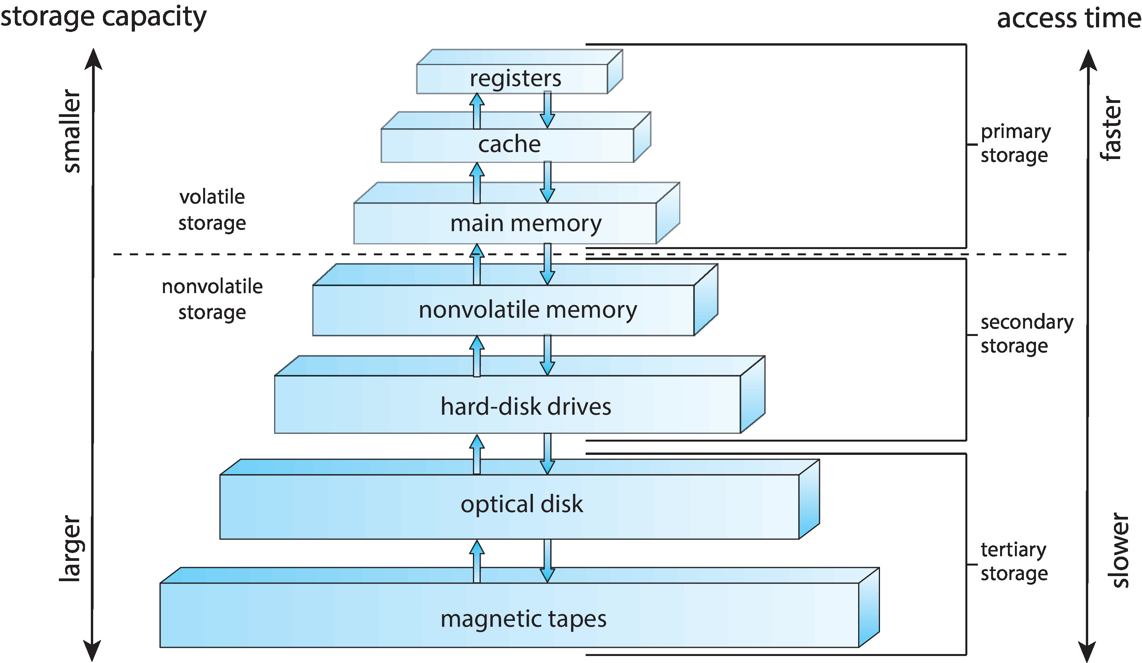
Storage-Device Hierarchy

Slide 16
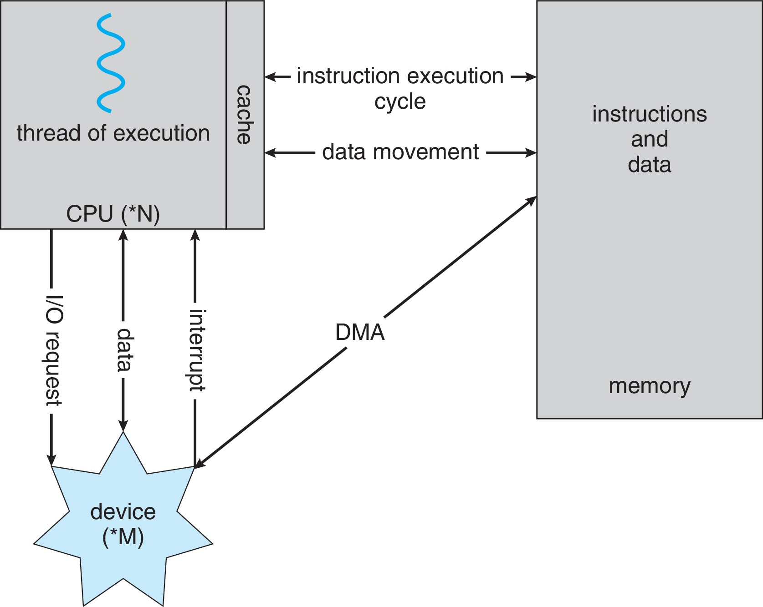
How a Modern Computer Works
A von Neumann architecture

Slide 17
Direct Memory Access Structure
Used for high-speed I/O devices able to transmit information at close to memory speeds
Device controller transfers blocks of data from buffer storage directly to main memory without CPU intervention
Only one interrupt is generated per block, rather than the one interrupt per byte

Slide 18
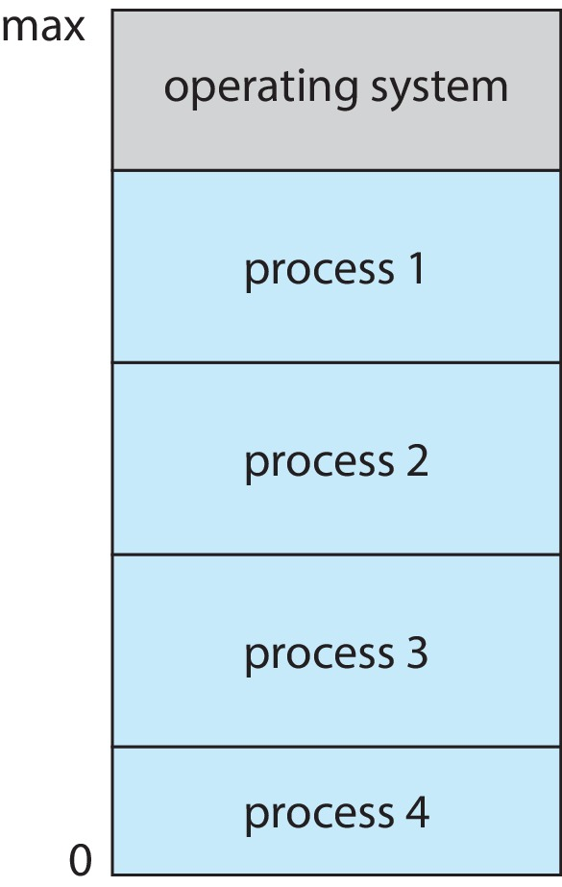
Concepts
Multiprogramming
Ability of operating system to run multiple programs
Single user cannot always keep CPU and I/O devices busy
Multiprogramming organizes jobs (code and data) so CPU always has one to execute
A subset of total jobs in system is kept in memory
One job selected and run via job scheduling
When job has to wait (for I/O for example), OS switches to another job
Multitasking (Timesharing)
A logical extension of multiprogramming– the CPU switches jobs so frequently that users can interact with each job while it is running, creating interactive computing
Response time should be < 1 second
Each user has at least one program executing in memory  process
If several jobs ready to run at the same time  CPU scheduling
Memory Layout for Multi programmed System

Slide 19
Concepts (cont.)
Dual-mode Operation
Dual-mode operation allows OS to protect itself and other system components
User mode and kernel mode
Mode bit:
Provides ability to distinguish when system is running user code or kernel code.
When a user is running  mode bit is “user”
When kernel code is executing  mode bit is “kernel”
How do we guarantee that user does not explicitly set the mode bit to “kernel”?
System call changes mode to kernel, return from call resets it to user
Some instructions designated as privileged, only executable in kernel mode

Slide 20
Timer
Timer to prevent infinite loop (or process hogging resources)
Timer is set to interrupt the computer after some time period
Keep a counter that is decremented by the physical clock
Operating system set the counter (privileged instruction)
When counter zero generate an interrupt
Set up before scheduling process to regain control or terminate program that exceeds allotted time

Slide 21
Process
A process is a program in execution. It is a unit of work within the system. Program is a passive entity; process is an active entity.
Process needs resources to accomplish its task
CPU, memory, I/O, files
data
Process termination requires reclaim of any reusable resources
Single-threaded process has one program counter specifying location of next instruction to execute
Process executes instructions sequentially, one at a time, until completion
Multi-threaded process has one program counter per thread
Typically system has many processes, some user, some operating system running concurrently on one or more CPUs
Concurrency by multiplexing the CPUs among the processes / threads

Slide 22
Memory Management
To execute a program all (or part) of the instructions must be in memory
All (or part) of the data that is needed by the program must be in memory
Memory management determines what is in memory and when
Optimizing CPU utilization and computer response to users
Memory management activities
Keeping track of which parts of memory are currently being used and by whom
Deciding which processes and data to move into and out of memory
Allocating and deallocating memory space as needed

Slide 23
File-system Management
OS provides uniform, logical view of information storage
Abstracts physical properties to logical storage unit - file
Each storage is controlled by device (i.e., disk drive, tape drive)
Varying properties include access speed, capacity, data-transfer rate, access method (sequential or random)
File-System management
Access control on most systems to determine who can access what
OS activities include
Creating and deleting files and directories
Manipulate files and directories
Mapping files onto secondary storage
Backup files onto stable (non-volatile) storage media

Slide 24
Mass-Storage Management
Usually disks used to store data that does not fit in main memory or data that must be kept for a “long” period of time
Proper management is of central importance
Entire speed of computer operation depends on disk subsystem and its algorithms
OS activities
Mounting and unmounting
Free-space management
Storage allocation
Disk scheduling
Partitioning
Protection

Slide 25
Caching
Information in use copied from slower to faster storage temporarily
Faster storage (cache) checked first to determine if information is there
If it is, information used directly from the cache (fast)
If not, data copied to cache and used there
Cache smaller than storage being cached
Cache management important design problem
Cache size and replacement policy

Slide 26
I/O Subsystem
One purpose of OS is to hide peculiarities of hardware devices from the user
I/O subsystem does the same for I/O devices.
I/O subsystem includes the following components:
Memory management of I/O including:
buffering (storing data temporarily while it is being transferred )
caching (storing parts of data in faster storage for performance)
General device-driver interface
Drivers for specific hardware devices

Slide 27
Protection and Security
Protection – any mechanism for controlling access of processes or users to resources defined by the OS
Define a base and a limit for each program and protect access outside allowed range to protect memory.
Security – defense of the system against internal and external attacks
Huge range, including denial-of-service, worms, viruses, identity theft, theft of service
Systems generally first distinguish among users, to determine who can do what
User identities (user IDs, security IDs) include name and associated number, one per user
User ID then associated with all files, processes of that user to determine access control
Group identifier (group ID) allows set of users to be defined and controls managed, then also associated with each process, file
Privilege escalation allows user to change to effective ID with more rights

Slide 28
Virtualization
Allows operating systems to run applications within other OSes
Vast and growing industry
VMM (virtual machine Manager) provides virtualization services

Slide 29
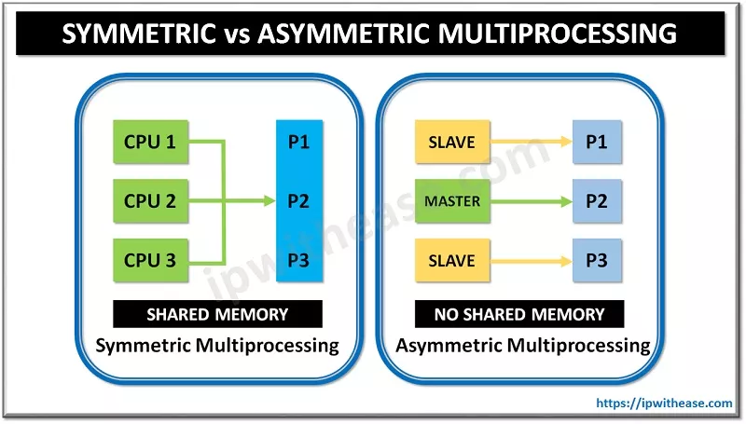
Computer-System Architecture
Most systems use a single general-purpose processor (CPU)
Most systems have special-purpose processors as well
Multiprocessors systems growing in use and importance
Also known as parallel systems, tightly-coupled systems
Advantages include:
Increased throughput
Economy of scale
Increased reliability
Two types:
Asymmetric Multiprocessing
each processor is assigned a specie task.
Symmetric Multiprocessing
each processor performs all tasks

Slide 30
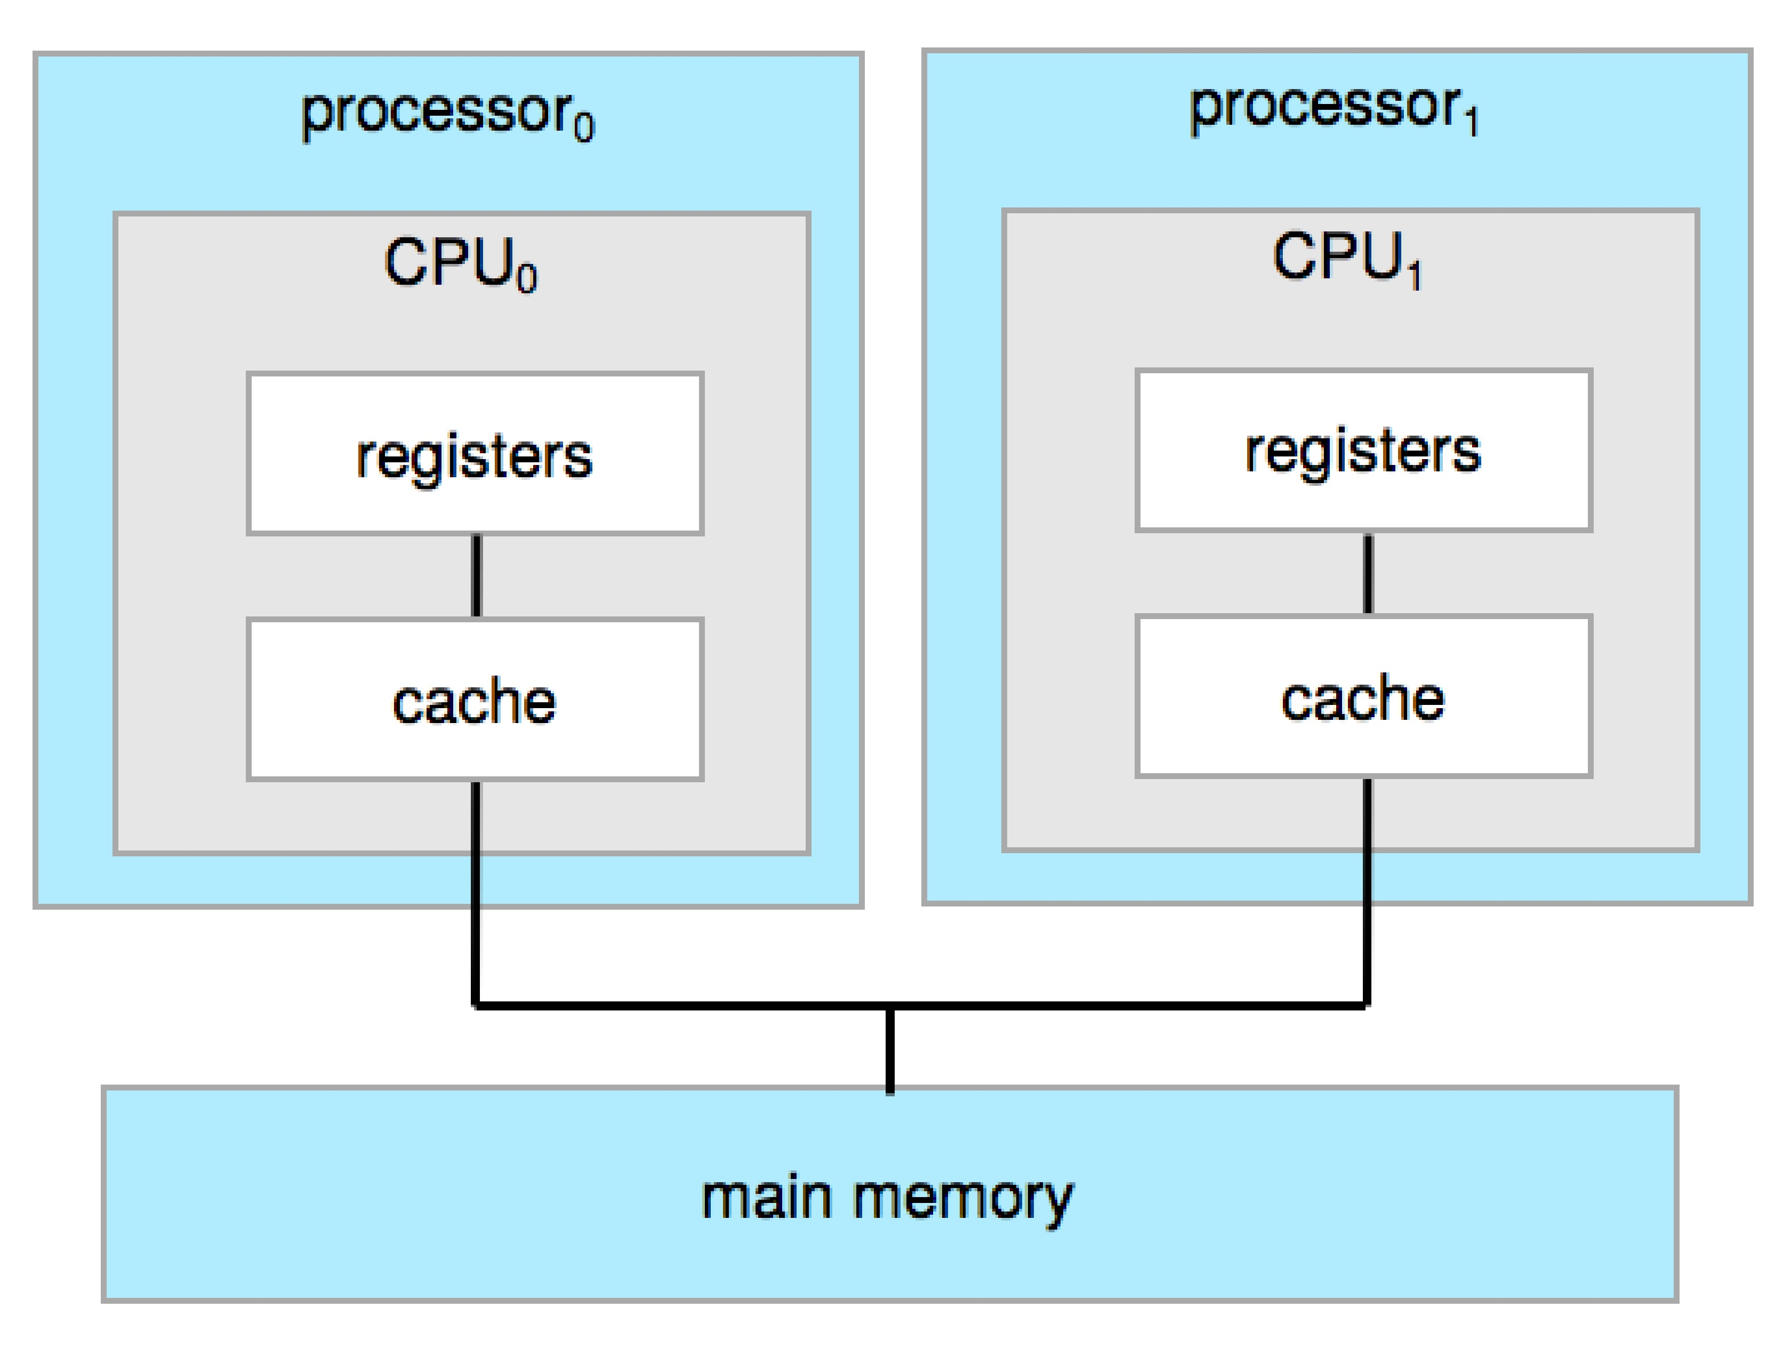
Symmetric Multiprocessing Architecture

Slide 31
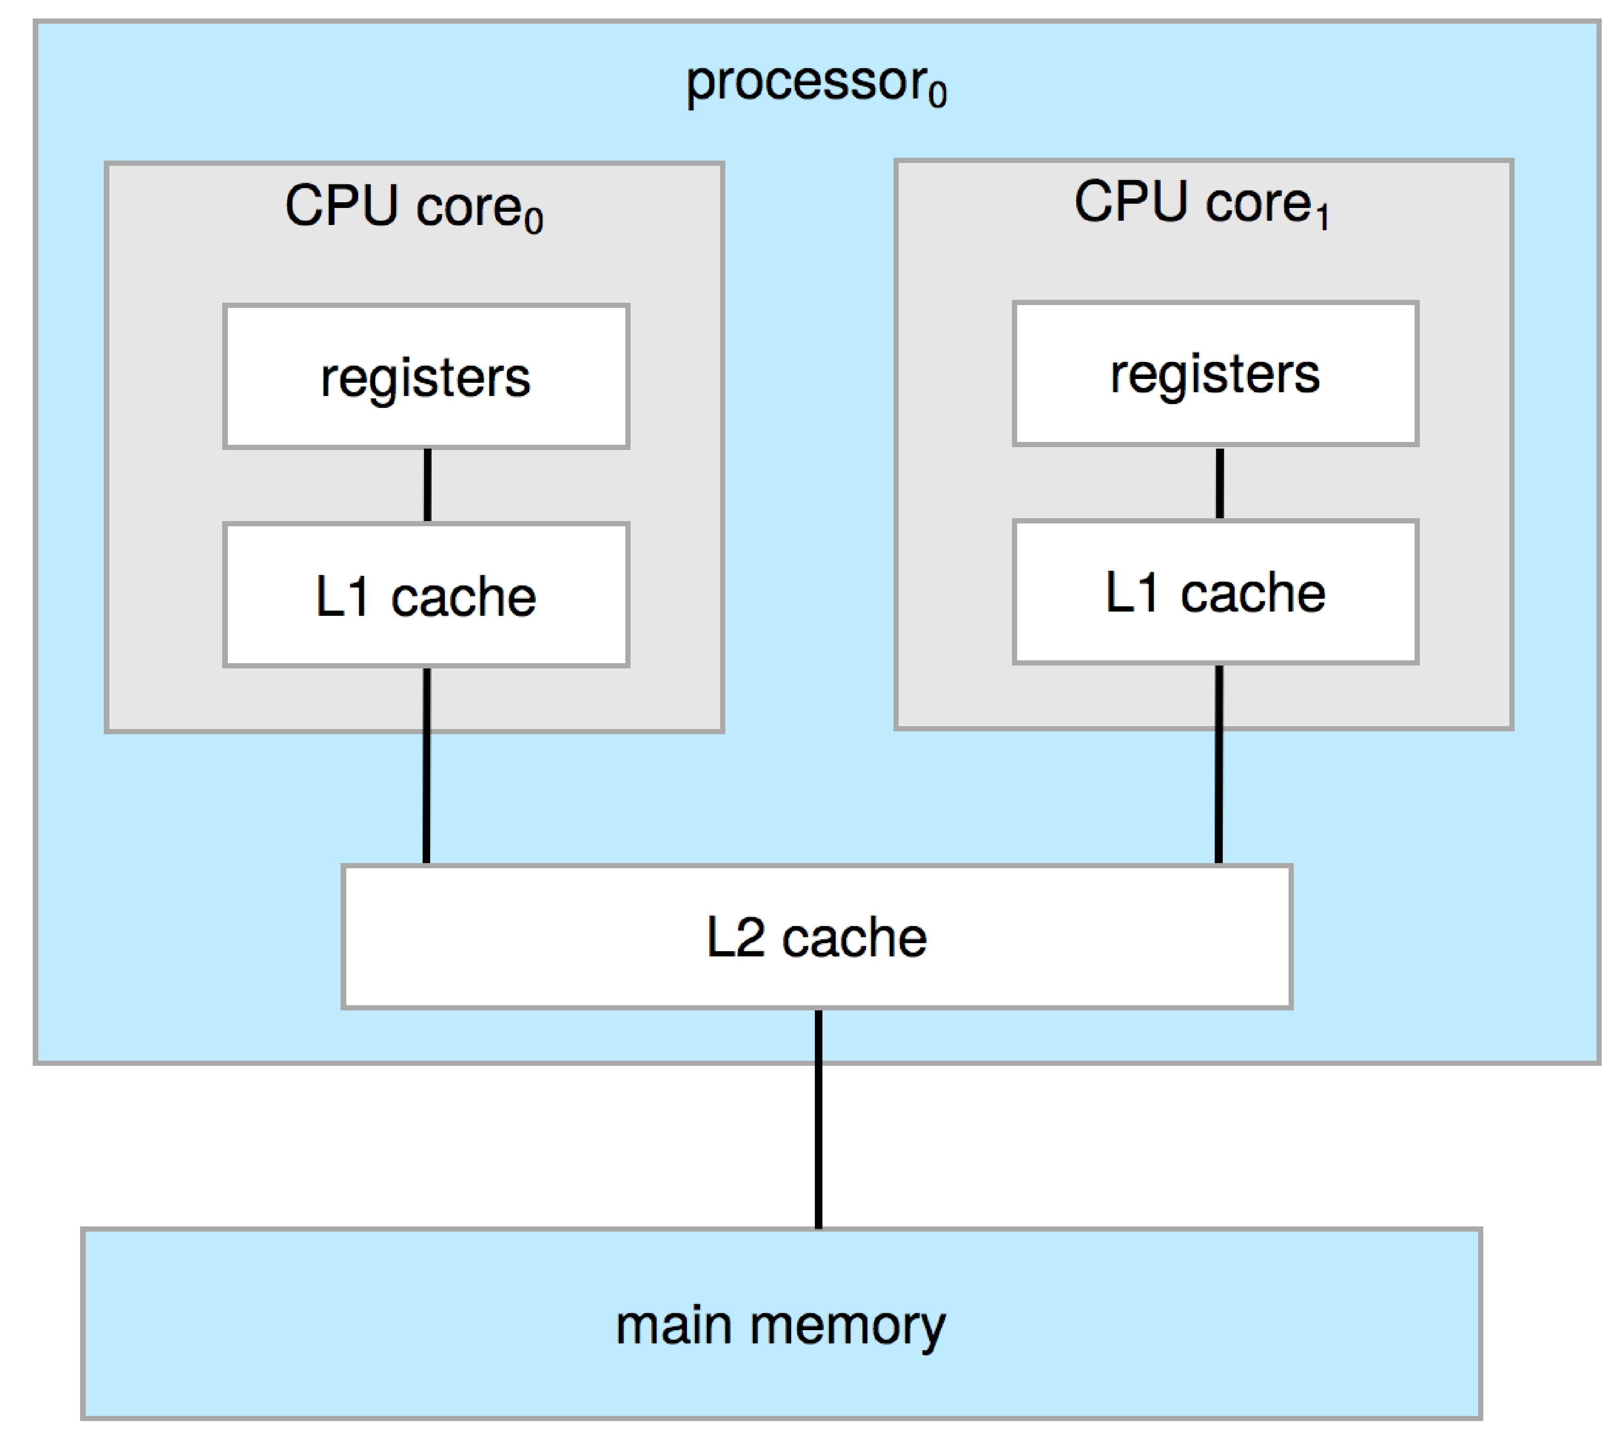
Dual-Core Design
Multi-chip and multicore
Hierarchical cache architecture

Slide 32
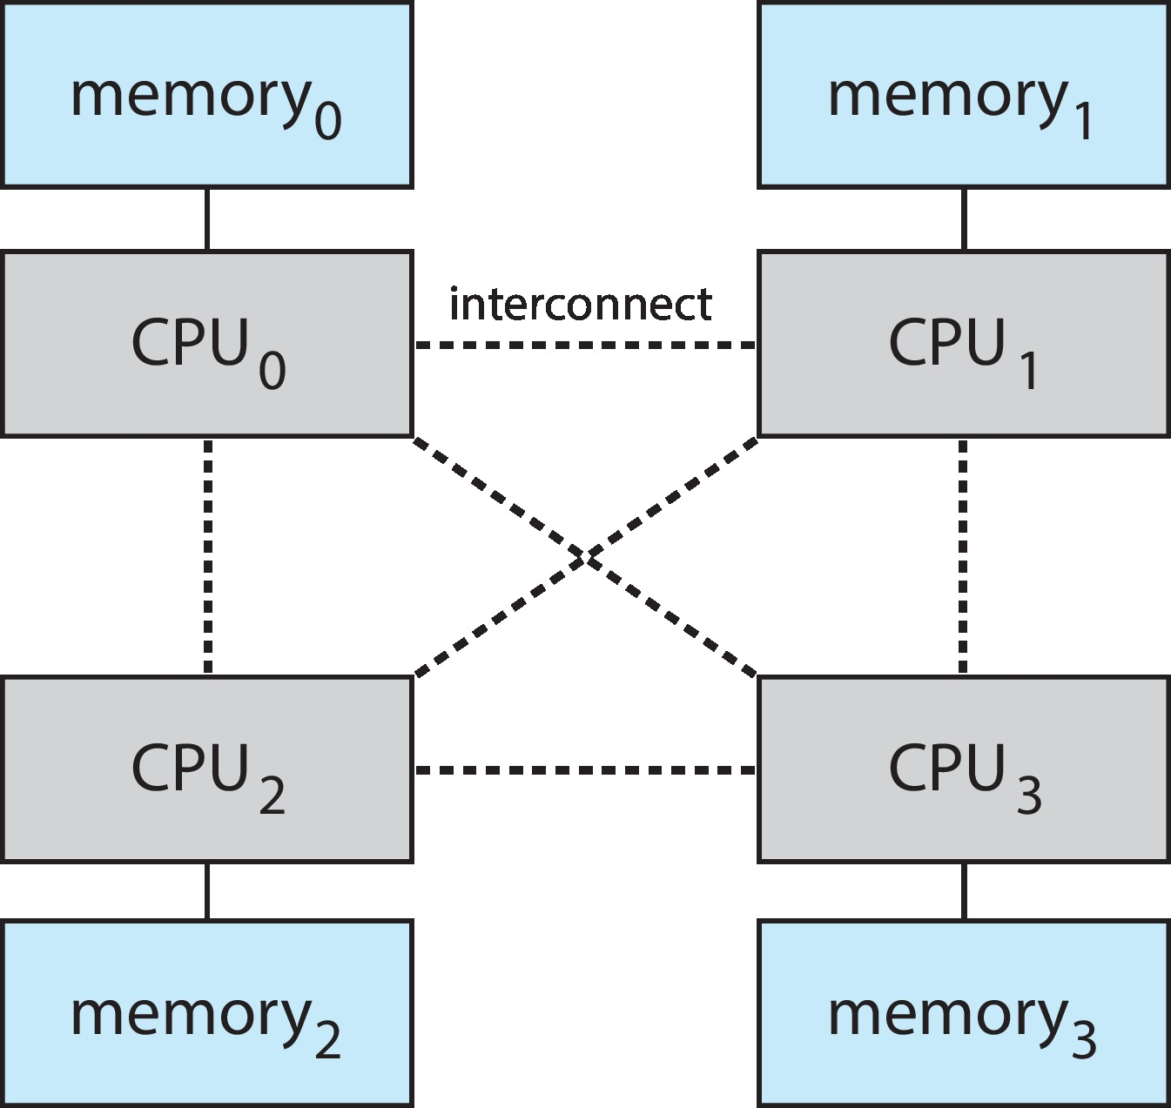
Non-Uniform Memory Access System

Slide 33
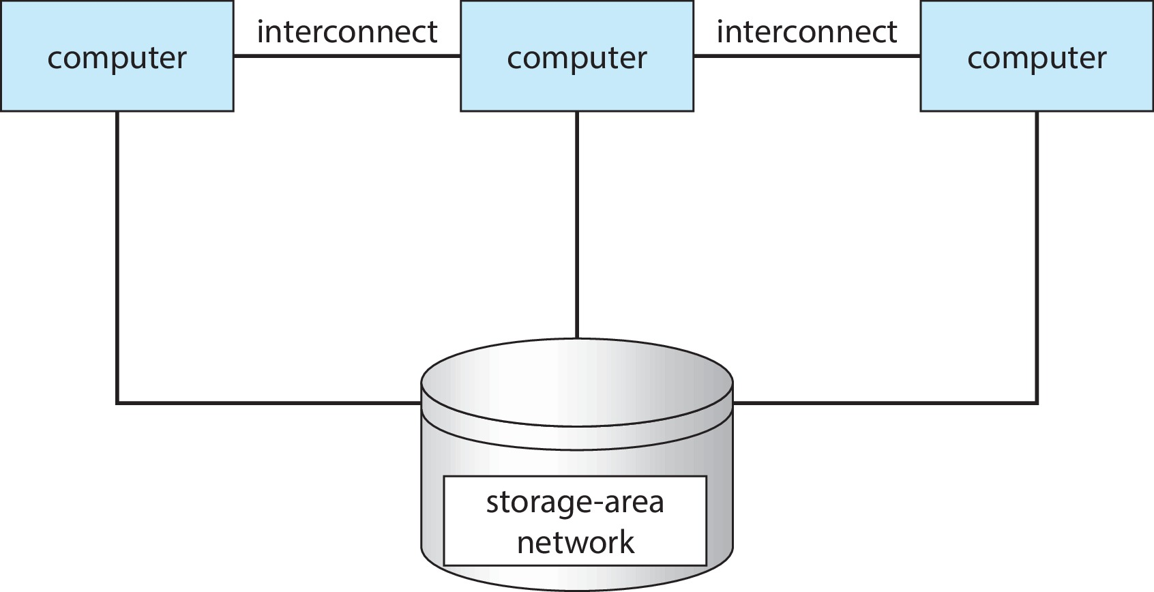
Clustered Systems
Like multiprocessor systems, but multiple systems working together
Usually sharing storage via a storage-area network (SAN)
Provides a high-availability service which survives failures
Asymmetric clustering has one machine in hot-standby mode
Symmetric clustering has multiple nodes running applications, monitoring each other
Some clusters are for high-performance computing (HPC)
Applications must be written to use parallelization
Some have distributed lock manager (DLM) to avoid conflicting operations

Slide 34
Kernel Data Structures
The way data are structured in the system.
Extensively used in operating systems.
Many similar to standard programming data structures.
Singly linked list
Doubly linked list
Circular linked list

Slide 35
Kernel Data Structures
Binary search tree left <= right
Search performance is O(n)

Slide 36
Kernel Data Structures
Hash function can create a hash map
Bitmap – string of n binary digits representing the status of n items
For example:
001011101
Resources 2, 4, 5, 6, and 8 are unavailable;
resources 0, 1, 3, and 7 are available.

Slide 37
End of Week 1

